Slide 1

Operation Analytics and
INVESTIGATING METRIC SPIKE
Trainity project by Vaishakh Menon

Slide 2

Table of
CONTENTS
01
02
03
04
Introduction
Tech-Stack Used
Insights
Case Study 1 :- Job Data Analysis
05
06
07
Case Study 2 :- Investigating Metric Spike
Outcomes
Results

Slide 3

INTRODUCTION
In this project, we must derive insights from the given dataset and tables to answer questions posed by different departments within the company. We use advance SQL queries to analyse the data and provide valuable insights that can help to improve the company's operations.

Slide 4





TECH-STACK USED
MySQL Workbeanch
Microsoft Word
Microsoft Excel
v8.0.36.0
Microsoft Powerpoint

Slide 5

INSIGHTS
Case Study 1
Job Data Analysis
1. Jobs Reviewed Over Time
Objective: Calculate the number of jobs reviewed per
hour for each day in November 2020.
Task: Write an SQL query to calculate the number of jobs
reviewed per hour for each day in November 2020.
2. Throughput Analysis
Objective: Calculate the 7-day rolling average of
throughput (number of events per second).
Task: Write an SQL query to calculate the 7-day rolling
average of throughput. Additionally, explain whether
you prefer using the daily metric or the 7-day rolling
average for throughput, and why.
3. Language Share Analysis
Objective: Calculate the percentage share of each language in the
last 30 days
Task: Write an SQL query to calculate the percentage share of
each language over the last 30 days.
4. Duplicate Row Detection
Objective: Identify duplicate rows in the data
Task: Write an SQL query to display duplicate rows from
the job_data table.
Job Data Table :- click Here for Table

Slide 6
INSIGHTS
Case Study 2
Investigating Metric Spike
1. Weekly User Engagement
Objective: Measure the activeness of users on a weekly basis.
Task: Write an SQL query to calculate the weekly user engagement.
2. User Growth Analysis
Objective: Analyse the growth of users over time for a product.
Task: Write an SQL query to calculate the user growth for the
Product.
3. Weekly Retention Analysis
Objective: Analyse the retention of users on a weekly basis after
signing up for a product.
Task: Write an SQL query to calculate the weekly retention of
users based on their sign-up cohort.
4. Weekly Engagement Per Device
Objective: Measure the activeness of users on a weekly basis per
device.
Task: Write an SQL query to calculate the weekly engagement per
device.
5. Email Engagement Analysis
Objective: Analyse how users are engaging with the email service.
Task: Write an SQL query to calculate the email engagement metrics.
Tables
Users Table
Events Table
Email_Events Table

Slide 7

Case Study 1
Job Data Analysis

Slide 8
1. Jobs Reviewed Over Time
136.81686
0.038000
Job Reviewed per hour for each day in November 2020
Job Reviewed per second each day in November 2020
Code and Output :- Click Here

Slide 9
2. Throughput Analysis
Code and Output :- Click Here
DATES
AVERAGE OF THROUGHPUT
26 – 11 - 2020
0.02
27 – 11- 2020
0.01
28 – 11 - 2020
0.06
29 – 11 - 2020
0.05
30 – 11 - 2020
0.05

Slide 10
3. Language Share Analysis
Code and Output :- Click Here

Slide 11


4. Duplicate Row Detection
Actor_ID
Duplicates
1003
2
Code and Output :- Click Here

Slide 12


Case Study 2
Investigating Matric Spike

Slide 13
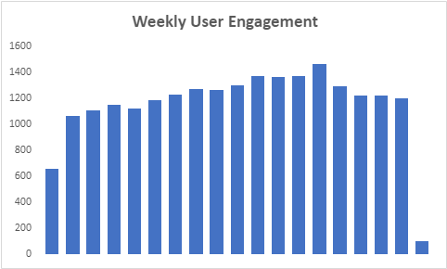
1. Weekly User Engagement
As per the analysis, In 30th week we got maximum active users 1467.
Code and Output:- Click Here

Slide 14
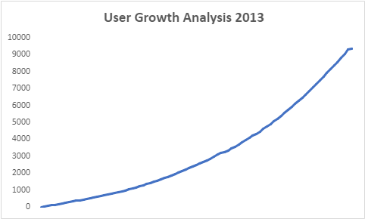
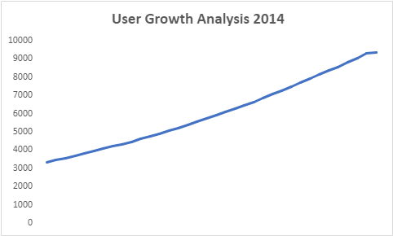
2. User Growth Analysis
From the analysis we can see that user growth are increasing each year.
Code and Output:- Click Here

Slide 15
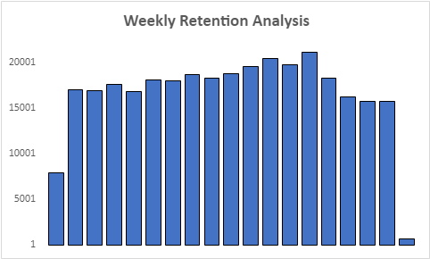
3.Weekly Retention Analysis
As per the analysis, In 30th week we got maximum users retained 21295.
Code and Output:- Click Here

Slide 16
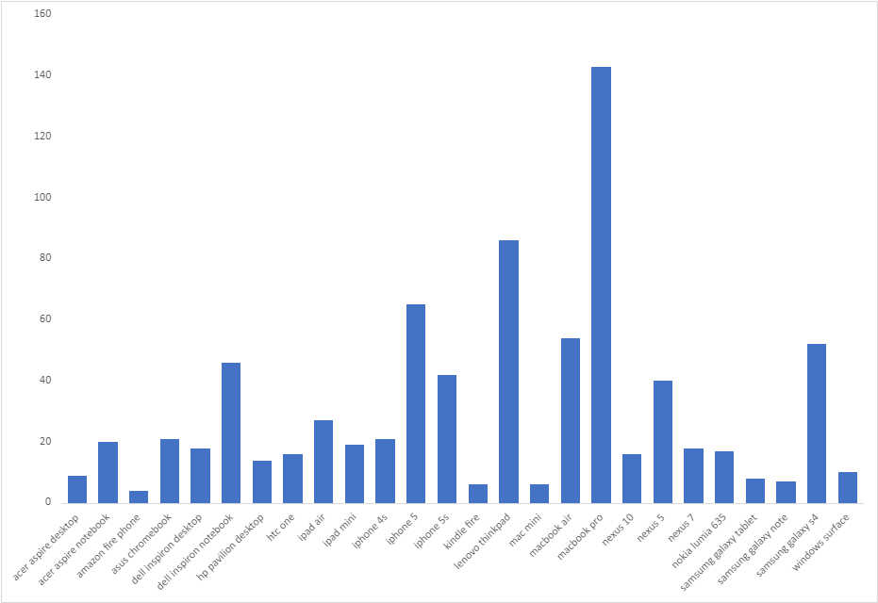
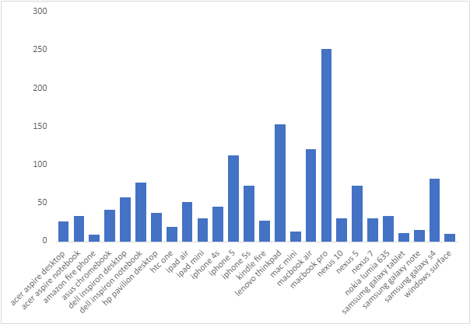
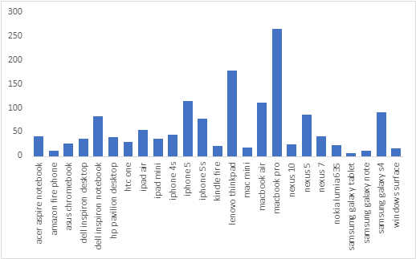
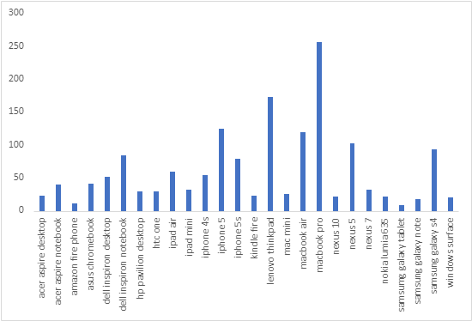
4. Weekly Engagement Per Device
Week 17
Week 18
Week 19
Week 20

Slide 17


4943 Users
After analyzing every week, we can see that most engaged device is MacBook Pro.
Code and Output:- Click Here

Slide 18
5. Email Engagement Analysis
33.5834
14.7899
Email Open Rate
Email Click Rate
Out of total email sent, around 33.59% of them were opened and only 14.79% of them were clicked.
Code and Output :- Click Here

Slide 19
Results
Job Data Analysis
Investigating Metric Spike
Total 136.82 job reviewed each hour of the day of the month of November 2020.
As per result, I prefer average rolling of throughout per day by which I can easily understand how many data are coming each day of the week.
The Persian language had the highest share among the languages(37.5).
Two duplicate rows detected or actor ID 1003.
On 30th week, we found the maximum active users.
The growth of users are rapidly increased from 2013 to 2014.
The maximum users we retained on the 30th week and minimum on 35th week.
Most of the users who were engaged using the "MacBook Pro" product.

Slide 20
THANK YOU

